Slide 1
optical fiber

Slide 2
Module 3 ( Part II)
Optical fibers:
Propagation mechanism, angle of acceptance, Numerical aperture, Modes of propagation, Types of optical fibers, Attenuation, and Mention of expression for attenuation coefficient. Discussion of a block diagram of point-to-point communication, Optical fiber sensors- Intensity-based displacement sensor and Temperature sensor based on phase modulation, Merits, and demerits, Numerical problems.

Slide 3
Optical fiber
An optical fiber is a flexible, transparent fiber made by drawing glass (silica) or plastic to a diameter slightly thicker than that of a human hair.
Optical fibers are used most often as a means to transmit light between the two ends of the fiber
It find wide usage in fiber-optic communications, where they permit transmission over longer distances and at higher bandwidths (data rates) than wire cables.

Slide 4
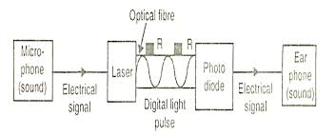
Fibers are used instead of metal wires because signals travel along them with lesser amounts of loss;
fibers are also immune to electromagnetic interference, a problem from which metal wires suffer excessively.

Slide 5
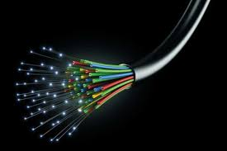
Fibers are also used for illumination, and are wrapped in bundles so that they may be used to carry images, thus allowing viewing in confined spaces, as in the case of a fiberscope.

Slide 6
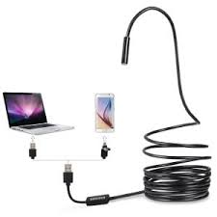
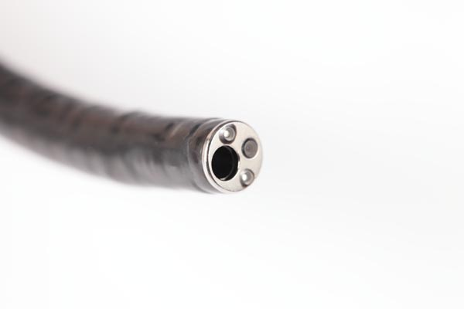
Specially designed fibers are also used for a variety of other applications,
In medical field --- Endoscope

Slide 7
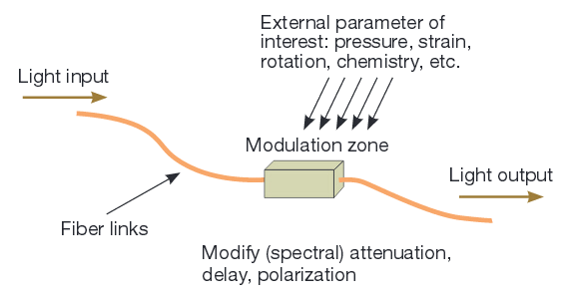
fiber optic sensors

Slide 8
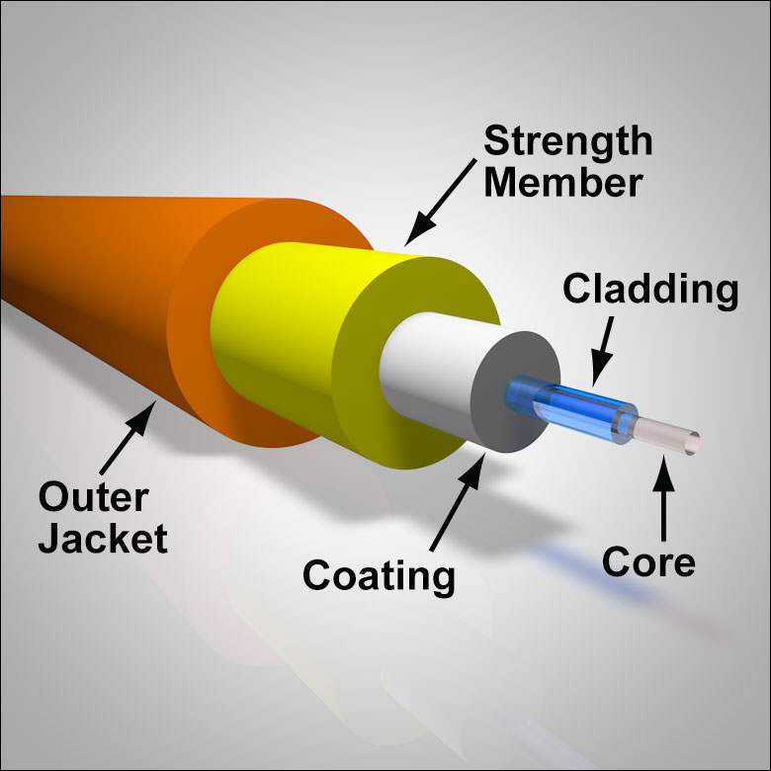
Structure
Optical fibers typically include a transparent core.
Surrounded by a transparent cladding material with a lower index of refraction.
Light is kept in the core by total internal reflection which causes the fiber to act as a waveguide.
Glass core with glass cladding
Plastic core with plastic cladding
3. Glass core with plastic cladding

Slide 9
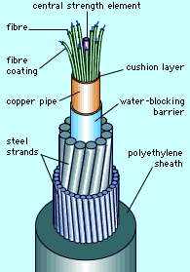
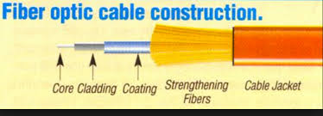

Slide 10
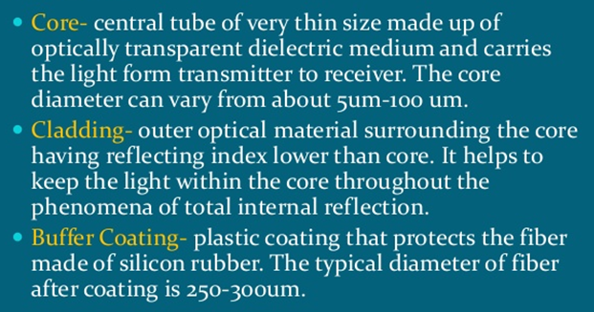
Principle - Total Internal Reflection

Slide 11
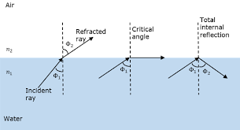
critical angle
This angle of incidence in the denser medium for which the refracted ray just grazes the surface of separation of the media or the angle of refraction is 90° is known as the critical angle (C)

Slide 12

From law of refraction (Snell’s law)
we have, n­₁ sin i = n₂ sin r
at i = C, r = 90°
n₁ sin C = n₂ sin 90° ⇒ n₁ sin C = n₂
sin C = $\frac{n_{2}}{n_{1}}$
or C = sin ^{– 1}

Slide 13
Total Internal Reflection
For a further increase in the angle of incidence (i.e., i > C) the ray is not refracted but gets reflected back into the same medium. This phenomenon is known as total internal reflection (TIR).
Condition of TIR:
1. The ray of light must travel from a denser medium into a rarer medium.
2. The angle of incidence in the denser medium must be greater than the critical angle for the given pair of media and the given colour of light.

Slide 14
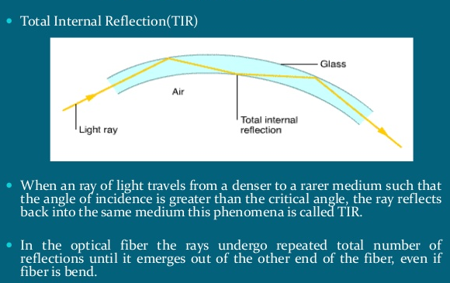
Working Principle

Slide 15
Numerical Aperture of Optical Fiber
Numerical aperture is abbreviated as NA and shows the efficiency with which light is collected inside the fiber in order to get propagated.
lost
Acceptance cone
90°
i < c
θ₁ (
B
C
i > c
C =90 -θ₁
θ₀
) θ₁
θ₀ (
Fiber axis
θ_{i} < θ₀
O
n₁
θ_{i} > θ₀
A
n₂
n₀
Incident ray
Core
Cladding
Angle θ₀ is called the acceptance angle and
sin θ₀ is called the numerical aperture (N.A) of the fiber

Slide 16
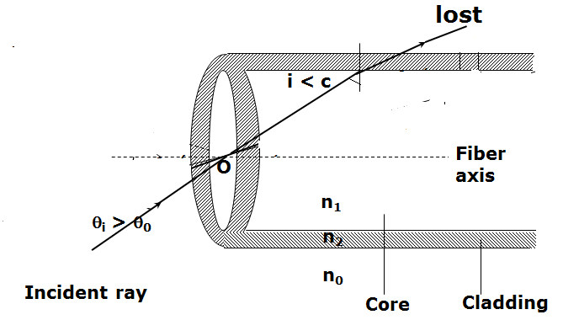
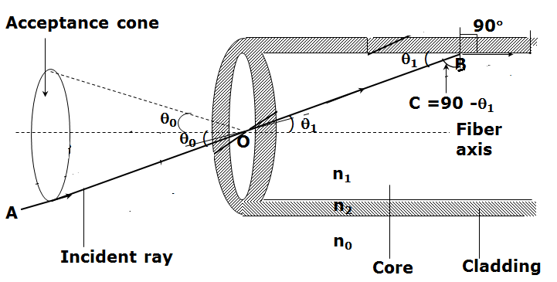
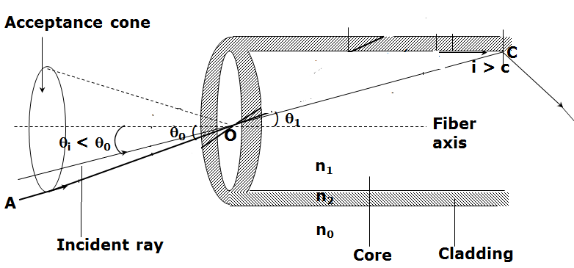

Slide 17
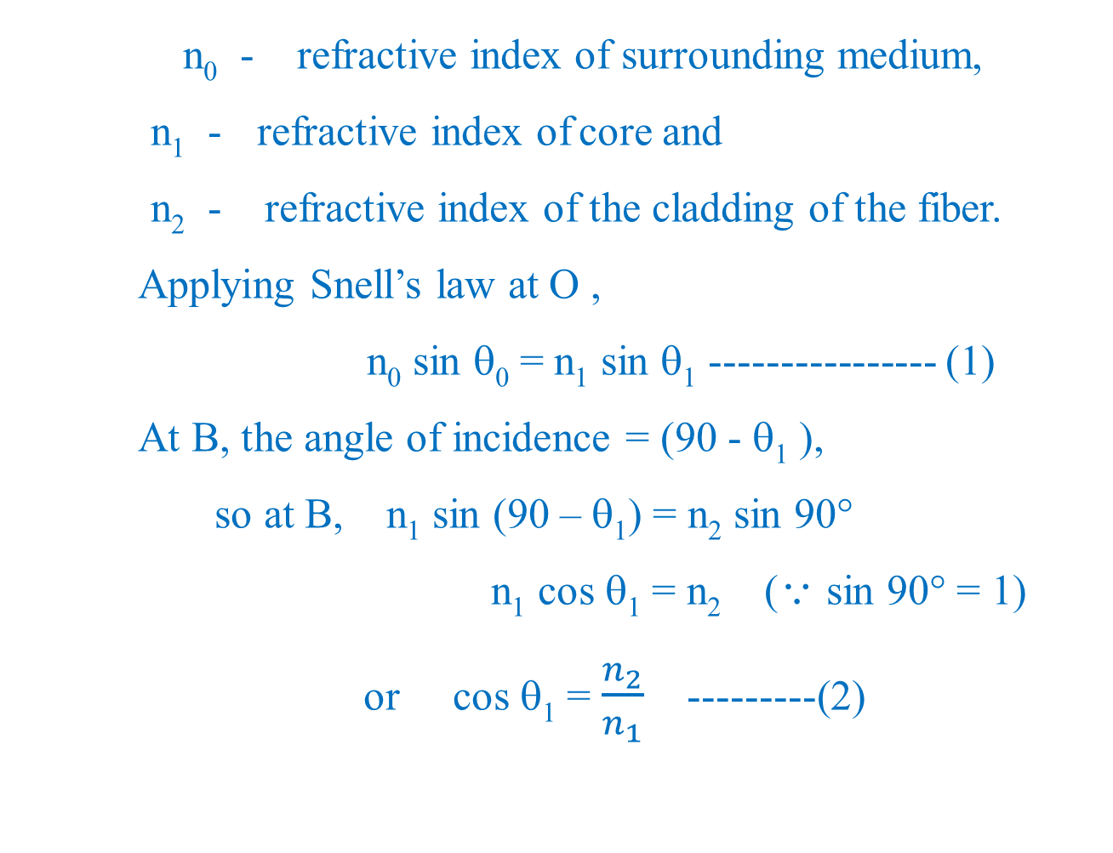
n₀ - refractive index of surrounding medium,
n₁ - refractive index of core and
n₂ - refractive index of the cladding of the fiber.
Applying Snell’s law at O ,
n₀ sin θ₀ = n₁ sin θ₁ ---------------- (1)
At B, the angle of incidence = (90 - θ₁ ),
so at B, n₁ sin (90 – θ₁) = n₂ sin 90°
n₁ cos θ₁ = n₂ ( sin 90° = 1)
or cos θ₁ = $\frac{n_{2}}{n_{1}}$ ---------(2)

Slide 18

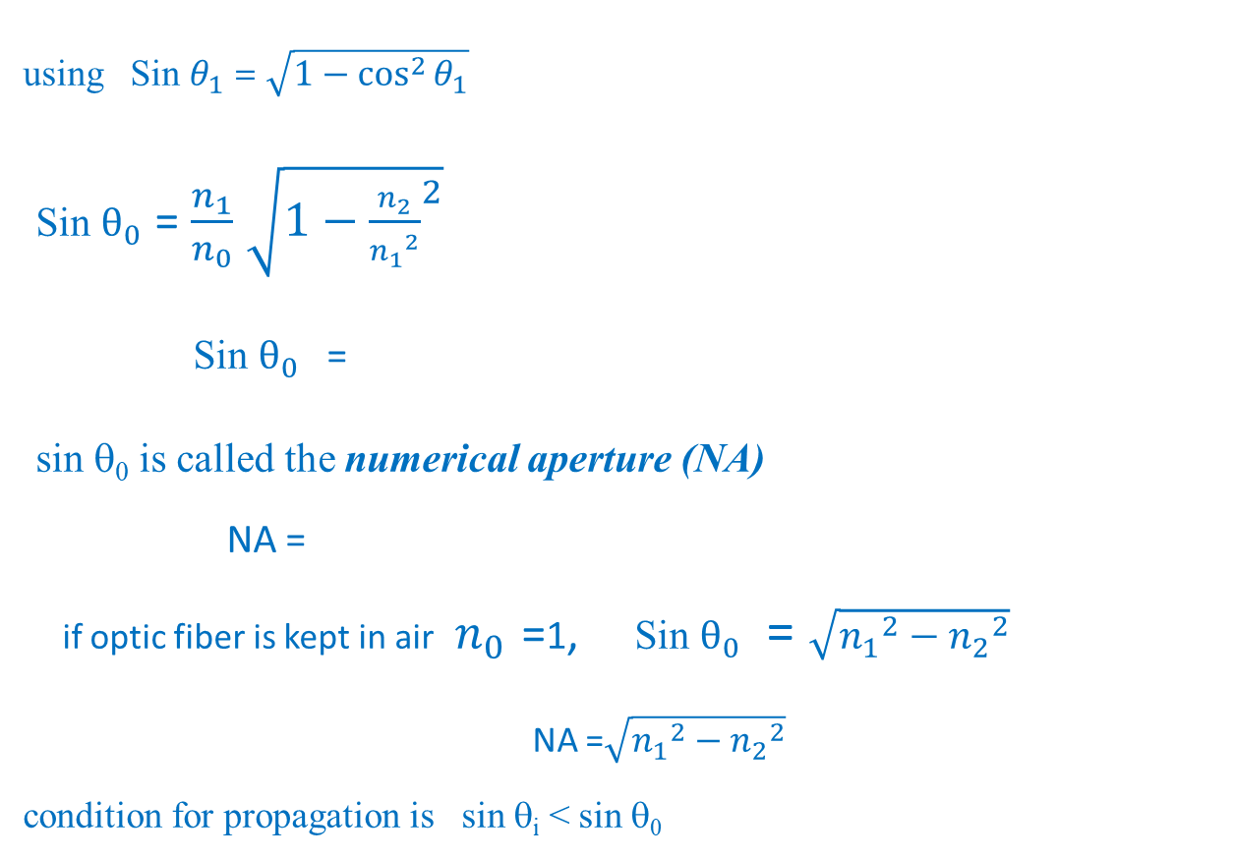
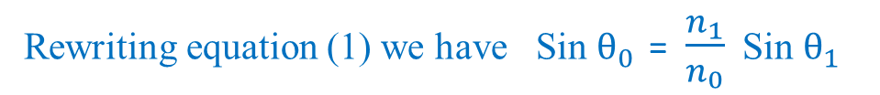
Rewriting equation (1) we have Sin $θ_{0}$ = $\frac{n_{1}}{n_{0}}$ Sin $θ_{1}$
using Sin $θ_{1}$ = $\sqrt{1−\cos^{2}{θ_{1}}}$
Sin $θ_{0}$ = $\frac{n_{1}}{n_{0}}$ $\sqrt{1−{\frac{n_{2}}{{n_{1}}^{2}}}^{2}}$
Sin $θ_{0}$ =
sin θ₀ is called the numerical aperture (NA)
NA =
if optic fiber is kept in air $n_{0 }$=1, Sin $θ_{0}$ = $\sqrt{{n_{1}}^{2}−{n_{2}}^{2}}$
NA =$\sqrt{{n_{1}}^{2}−{n_{2}}^{2}}$
condition for propagation is sin θ_{i} < sin θ₀

Slide 19
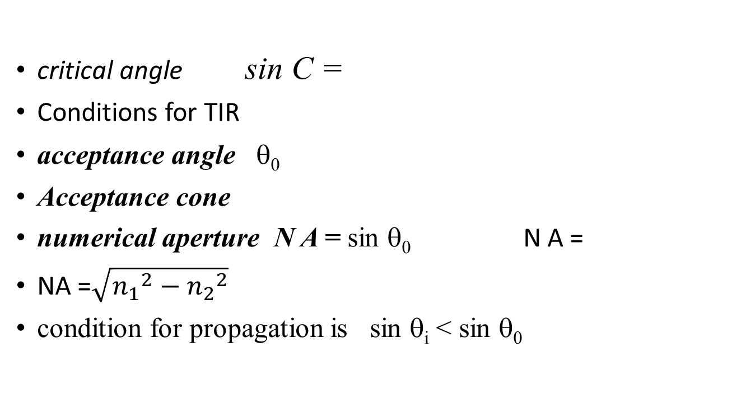
critical angle sin C =
Conditions for TIR
acceptance angle θ₀
Acceptance cone
numerical aperture N A = sin θ₀ N A =
NA =$\sqrt{{n_{1}}^{2}−{n_{2}}^{2}}$
condition for propagation is sin θ_{i} < sin θ₀

Slide 20
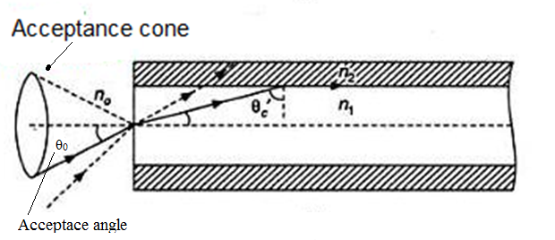

Slide 21

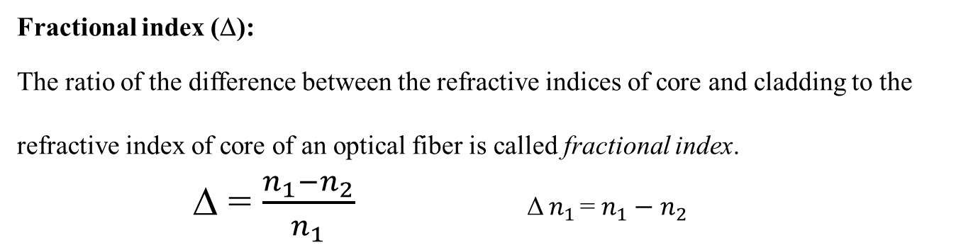



Fractional index (Δ):
The ratio of the difference between the refractive indices of core and cladding to the refractive index of core of an optical fiber is called fractional index.
Δ = $\frac{n_{1}−n_{2}}{n_{1}}$ Δ $n_{1 }$= $n_{1}−n_{2}$
NA =$\sqrt{{n_{1}}^{2}−{n_{2}}^{2}}$
= $\sqrt{(n_{1}+n_{2})(n_{1}−n_{2})}$
= $\sqrt{2n_{1}∆n_{1}}$
NA = $n_{1}\sqrt{2∆}$

Slide 22
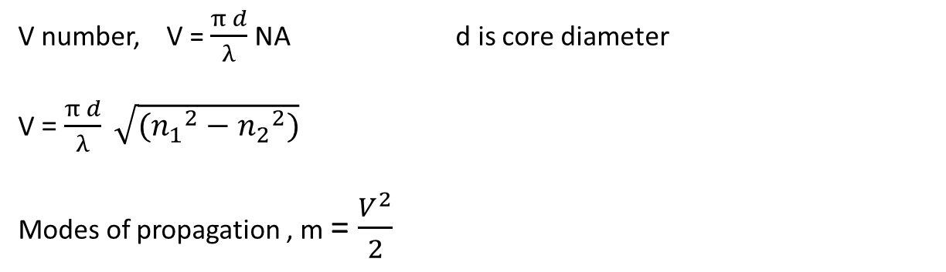
V number, V = $\frac{π d}{λ}$ NA d is core diameter
V = $\frac{π d}{λ} \sqrt{({n_{1}}^{2}−{n_{2}}^{2})}$
Modes of propagation , m = $\frac{V^{2}}{2}$

Slide 23
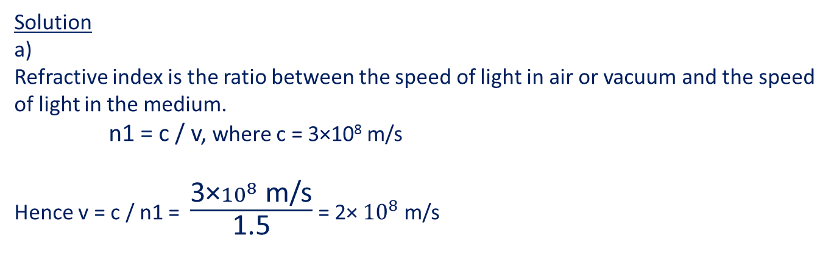
Numericals
Q1. In an optical fiber the core has a refractive index equal to 1.5 and cladding refractive index of 1.4. a) What is the speed of light inside the core? b) What is the critical angle at the core-cladding interface? c) What is the maximum angle that the rays leaving the source of light should make with the axis of the fiber so that total internal reflections takes place at the core cladding interface?
Solution a) Refractive index is the ratio between the speed of light in air or vacuum and the speed of light in the medium. n1 = c / v, where c = 3×10⁸ m/s
Hence v = c / n1 = $\frac{\text{3×}{10}^{8} \text{m}\text{/}\text{s}}{\text{1.5}}$ = 2× ${10}^{8}$ m/s

Slide 24
b) Critical angle i_{c} is such that
sin i_{c} = n₂ / n₁
i_{c} = sin⁻¹ ( n₂ / n₁ )
= sin⁻¹ (1.4 / 1.5)
≈ 69°
c)

Slide 25
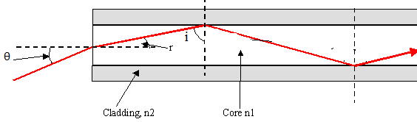
In order to have total internal reflection, we need to have i > i_{c} i = 90 - r Hence 90 - r > i_{c} r < 90 - i_{c} r < 21° n₀ sinθ = n₁sin r n₀= 1 ,
θ = sin⁻¹( 1.5 sin 21) = 32.5 º
Maximum angle must be smaller than 32.5 ° in order to have total internal reflection at the core-cladding interface.

Slide 26
Q2. A step-index fiber has a core index of refraction of n₁ = 1.425.
The cut-off angle for light entering the fiber from air is found to be 8.50º.
(a) What is the numerical aperture of the fiber?
(b) What is the index of refraction of the cladding of this fiber?
(c) If the fiber were submersed in water, what would be the new numerical aperture and cut-off angle?
Solution
For air, n₀ = n_{air} = 1
The numerical aperture is NA = n₀ sin θ₀
= (1) sin (8.50º)
= 0.148.

Slide 27
b) The index of refraction of the cladding can be found from the numerical aperture:
n₁² - n₂² = NA² n₂² = n₁² - NA²
= (1.425)² - (0.148)²
= 2.008 n₂ = 1.417.

Slide 28
c) If the fiber is submersed in water n₀ = n_{water} = 1.33.
NA_{medium} n_{medium} = NA_{air}
NA = n₀ sin θ₀
NA = 0.148. sin θ₀ = NA/n₀ θ₀ = sin⁻¹(NA/n₀)
= sin⁻¹(0.148/1.33)
= sin⁻¹(0.1112)
cut off angle = 6.38º.

Slide 29

Q3. What is the numerical aperture of a fiber having a core index of 1.57 and a cladding index of 1.49?
Numerical Aperture
NA = $\sqrt{({n_{1}}^{2}−{n_{2}}^{2})}$
= $\sqrt{({1.57}^{2}−{1.49}^{2 })}$
=0.495

Slide 30
Q4. A fiber has a numerical aperture of 00.279 . What is the cut-off angle (in degrees) for this fiber if the fiber is surrounded by vacuum?
NA = sin θ₀
θ₀ = sin⁻¹(NA)
= sin⁻¹(0.279)
= 16.2 ⁰

Slide 31
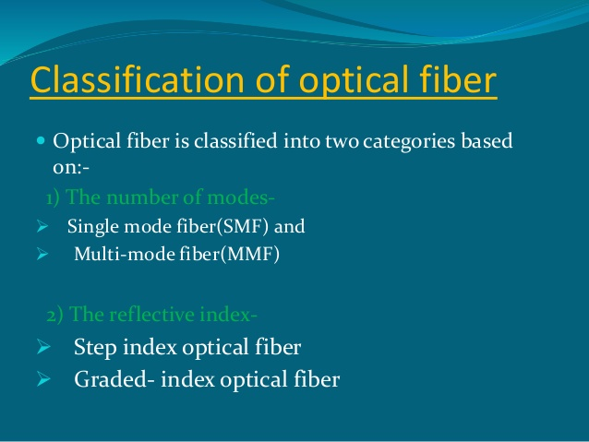

Slide 32
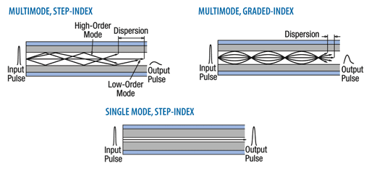
Types of optical fibers and modes of propagation:
There are mainly three types of optical fibers, they are
Step – index single mode fiber
Step – index multi-mode fiber
Graded – index multimode fiber

Slide 33
There are mainly three types of optical fibers
Step – index single mode fiber
Step – index multi-mode fiber
Graded – index multimode fiber
This classification is done depending on the refractive index profile, and the number of modes that the fiber can guide.

Slide 34
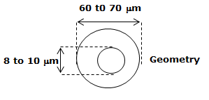
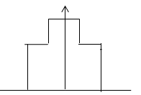

Step – index single – mode fiber
Cladding
n₂
Core
n₁
Light ray
n₂
n
n1
n2
Input pulse
Output pulse

Slide 35
Core of uniform refractive index (n₁).
Cladding of uniform refractive index (n₂) lower than that of core.
A sudden decrease in the value of refractive index at core to cladding.
R.I. profile takes the shape of a step.
The diameter of the core is 8 – 10 μm
External diameter of cladding is 60 – 70 μm
Since the core is narrow, it can guide just a single mode.
Hence it is called single mode fiber.
Single mode fibers are commonly used in long distance applications
They need lasers as the source of light.
They find application in submarine cable system.

Slide 36
2. Step – index Multimode fiber
Higher order mode
100 to 250 μm
Cladding
50 to
200 μm
Core
Geometry
R.I
Profile
R.I
← Radial distance →
Input pulse
Output pulse

Slide 37
It is similar to step index single mode fiber except the
diameter of the core is very large compared to the single mode fiber.
It is about 50 to 200 μm.
Cladding diameter 100 to 250 μm
Thus a large number of rays propagate in the fiber.
Its refractive index profile is similar to that of a step index single mode fiber,
Source used in this type of fiber is either LED or laser.
The rays travel in a zig-zag manner, in which the high angle modes travel a longer distance as compared to the low angle modes, causing intermodal dispersion.
Therefore a sharp pulse broadens as it travels long distances in the fiber, which in turn limits the communication distance

Slide 38
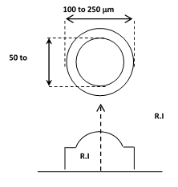
3. Graded index Multimode fiber
Cladding
Core
200μm
← Radial distance →
Input pulse
Output pulse

Slide 39

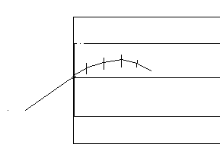

Slide 40
Graded index multimode fiber is similar to that of the step-index multimode fiber in geometry.
Core diameter is about 50 to 200 μm.
Cladding diameter 100 to 250 μm
Core material refractive index value decreases radially outward from the axis and becomes equal to that of the cladding at the interface.
The refractive index of the cladding remains uniform.
The source used is either a laser or LED.

Slide 41
In this fiber many modes can be transmitted.
The rays move in a sinusoidal path through the core.
Light travels at a lower speed in the high refractive index region of the core (n = c/v) than that in the low refractive index region.
Since the fastest components of the rays take the longer path and the slower components take the shorter path in the core, the time of travel of the different modes will be almost same.
This reduces the effect of intermodal dispersion.
Therefore losses are minimum with little pulse broadening.

Slide 42

Single mode (mono-mode) Fibers • SMFs:
Most important for long-distance use (Telecommunication).
Small core (8 to 10 microns) that forces the light to follow a linear single path down its length.
Lasers are the usual light source.
delicate to handle,
Highest bandwidths (GHz) and distance ratings (more than 100 km).
Multimode fibers:MMFs
Relatively large diameter core (50 to 100 microns)
Step-index multimode cable has an abrupt change between core and cladding. It is limited to about 50 Mbits/sec
Graded-index multimode cables has a gradual change between core and cladding. It is limited to 1 Gbit/sec. using incoherent and coherent sources (LEDs and Diode lasers); LANs
for SMF, V < 2.405 for MMF V > 10
Step index m= $\frac{V^{2}}{2}$ Graded index m= $\frac{V^{2}}{4}$

Slide 43

Attenuation
$\frac{dP}{dL}$ $∝$ –P
$\frac{dP}{dL}$ $=$ - αP α is the attenuation coefficient
$\frac{dP}{P}$ $=$ - αdL

Slide 44

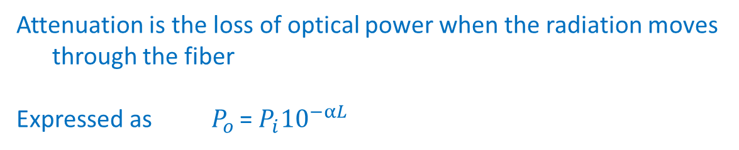
Attenuation is the loss of optical power when the radiation moves
through the fiber
Expressed as $P_{o }$= $P_{i}{10}^{−αL}$
The net attenuation for 1 Km length of fibre is given by a factor called attenuation coefficient (α),
in dB/km
It is expressed by the relation, α = (dB/km)
OR α = $\frac{10}{L}\log{\frac{P_{i}}{P_{o}}}$
Where P­_{in} is the power coupled into the power (power of the input signal)
P_{out} is the power output at the end (power of the output signal)
L is the length of the fiber in km

Slide 45
Mechanisms of Attenuation
Absorption loss
Scattering loss
Bending Losses (Radiation loss)
Coupling Loss

Slide 46
a. Absorption losses:
The loss of signal power occurs due to absorption of photons associated with signal. Photons are absorbed by
1) Impurities in the silica glass of which the fiber is made of
2) Intrinsic absorption by the glass material itself.

Slide 47
1. Absorption by impurities:
The impurities that are present in fiber glass are iron, chromium, cobalt & copper.
During signal propagation photons interact with these impurities, the electrons (in the impurities) absorb the photons and get excited to higher energy level.
Later these electrons give up their absorbed energy either as heat or light energy
The re-emission of light is of no use, since it will usually be in a different wavelength or in different phase with respect to the signal.
Hence it is a loss.
2. Intrinsic absorption:
The fiber itself has a tendency to absorb light energy however small it may be. Hence there will be a loss and is termed as intrinsic absorption

Slide 48
b. Scattering losses:
•
(Rayleigh Scattering)
Defect
The power loss due to the scattering of light energy due to the obstructions caused by imperfections and defects, which are of molecular size, present in the fiber itself.
The scattering of light is inversely proportional to the 4th power of the wavelength of light transmitted through the fiber.
Such a scattering is called Rayleigh scattering.
The loss due to the scattering can be minimized by using the optical source of large wave length.

Slide 49
c. Bending Losses (Radiation losses):
Radiation losses occur due to bending of fiber. There are two types of bends.
1. Microscopic bend.
2. Macroscopic bend
These bends are caused during manufacture as well as due to the applied stress on the fiber.
At the point of bend the light will escape to the surrounding medium due to the fact that the angle of incidence at that point becomes lesser than the critical angle.
Hence it will not undergo total internal reflection.
In order to avoid this type of losses, the optical fiber has to be laid without sharp bends and they should be freed from the external stresses by providing mechanical strength by external encasements.

Slide 50
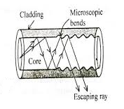
1. Microscopic bend.

Slide 51
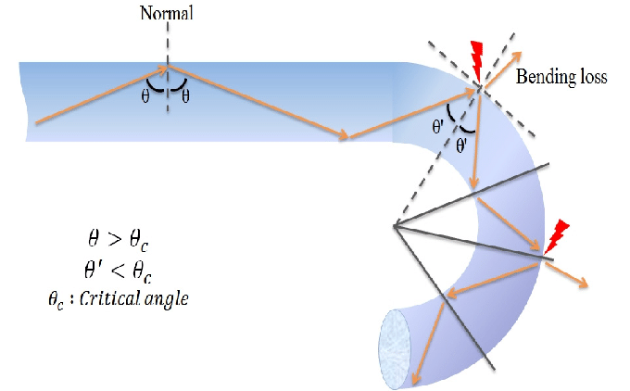
2. Macroscopic bend

Slide 52
d. Coupling losses:
Coupling losses occur when the ends of the fibers are connected.
At the junction of coupling, a film may exist or joint may be inclined or may be mismatched and they can produce a loss.
This is known as coupling loss.
This loss can be minimized by a technique called splicing.

Slide 53
Optical fiber
Lecture : 4

Slide 54
Application of Fiber Optics:
Point to Point communication:
Binary electrical
signals

Information such
as voice – analog
(Electrical)
Coder
Optical Fiber
Optical Transmitter
Light Source
Photo detector
Information again in analog form

Decoder
Binary electrical
Signals

Slide 55
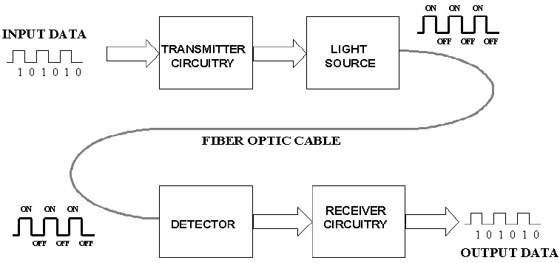

Slide 56
Analog information such as voice of a telephone user gives rise to electrical signal in analog form.
This analog signal is converted into binary data using coder.
The binary data comes out as a stream of electrical pulses from the coder.
These electrical pulses are transformed into optical power with the help of an optical source such as LED or lasers.
This unit is called as optical transmitter from which the optical power is fed into the fiber.
Only certain modes of the incident light, which enters into the core within the acceptance cone will be sustained for propagation within the fiber by means of total internal reflection.
Finally at the receiving end, the optical signal from the fiber is fed into a photo detector, where the signal is converted into pulses of electric current
which is then fed to decoder which converts the binary data into analog signal which will be the same information as voice.

Slide 57
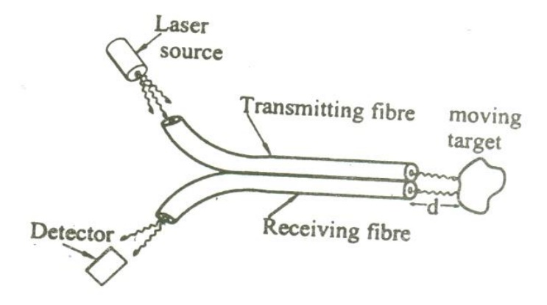
Intensity based displacement optical fiber sensor (Extrinsic Sensor)
Principle: Light sent through a transmitting fiber and is made to fall on the moving target. The reflected light from the target is sensed by a detector. With respect to intensity of light reflected from it the displacement of the target is measured.

Slide 58
Construction
It consists of a bundle of transmitting fibers coupled to the laser source and a bundle of receiving fibers coupled to the detector as shown in figure. The axis of transmitting fiber and the receiving fiber with respect to the moving target can be adjusted to increase the sensitivity of the sensor.

Slide 59
Working
Light from the source is transmitted through transmitting fiber and is made to fall on the moving target. The light reflected from the target is made to pass through the receiving fiber and the same is detected by the detector.
Based on the intensity of light received, the displacement of the target can be measured, i.e. if the received intensity is more then we can say that the target is moving towards the sensor and if the intensity is less, we can say that the target is moving away from the sensor.

Slide 60
Temperature / Pressure optical fiber sensor based on phase modulation (Intrinsic Sensor)
Principle:
It is based on the principle of interference between the beams emerging out from the reference fiber and the fiber kept in the measuring environment.
Reference fiber which is isolated from the environment
Test fiber kept in the environment to be sensed, are placed as shown in the figure. Separate lens systems are provided to split and to collect the beam.

Slide 62
Working:
A monochromatic source of light is emitted from the laser source.
The beam splitter kept at an angle 45º inclination divides the beam emerging from the laser source into two beams (i) main beam and (ii) splitted beam, exactly at right angles to each other.
The main beam passes through the lens L1 and is focused onto the reference fiber which is isolated from the environment to be sensed.
The beam after passing through the reference fiber then falls on the Lens L2.
The splitted beam passes through the Lens L3 and is focused onto the test fiber kept in the environment to be sensed.
The splitted beam after passing through the test fiber is made to fall on lens L2.
The two beams after passing through the fibers, produces a path difference due to change in parameters such as pressure, temperature etc in the environment.
Therefore a path difference is produced between two beams causing the interference pattern as shown in the figure.
Thus the change in pressure or temperature can be accurately measured with the help of the interference pattern obtained.

Slide 63
Advantages of optical fiber over copper cable
Quality of the communication is better because power loss is less.
Optical fibers are not affected by corrosion.
Since the frequency of light is large i.e. 10¹⁴ Hz, large bandwidth is available and transfer speed is high.
Optical Fiber is made of dielectric medium therefore communication system (optical signal) is not affected by electro−magnetic disturbances like thunderstorm.
Signal travelling in one optical fiber does not gives rise to induce the signal in the neighboring fiber therefore, there is no cross link.
Since the thickness of the optical fiber is very less we can accommodate more channels as compared to the copper cables for the same number of communication channels.
There is a good electrical isolation between transmitter and receiver

Slide 64
Disadvantages
1. Optical connectors used for connecting two fibers are highly expensive.
2. Whenever a fiber suffers a line break, operations required to establish the connections are highly skillful and time consuming.
3. Fibers undergo expansion and contraction with temperature that upset some critical alignments, which lead to loss in signal power.
4. Maintenance cost of the systems with optical fiber is very high.
5. Optical fiber break if sharply bent.

Slide 65
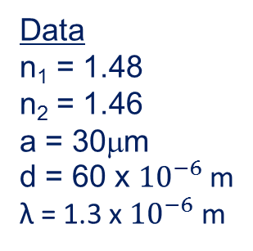
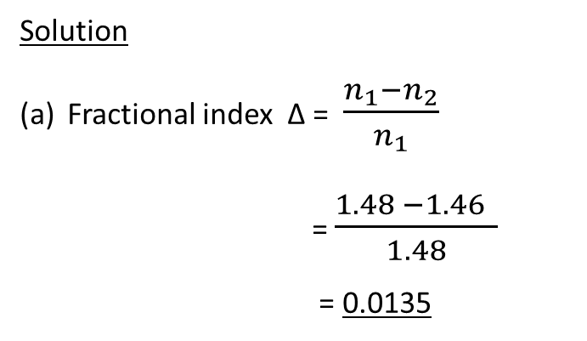
5.For a fibre with n₁ = 1.48, n₂ = 1.46 and core radius a = 30μm.
(a)Calculate the fractional index change. (b) the V number and the
number of modes the fiber supports for wavelength 1.3 μm.
Data
n₁ = 1.48
n₂ = 1.46
a = 30μm
d = 60 x ${10}^{−6}$ m
λ = 1.3 x ${10}^{−6}$ m
Solution
Fractional index Δ = $\frac{n_{1}−n_{2}}{n_{1}}$
= $\frac{1.48 −1.46 }{1.48}$
= 0.0135

Slide 66

(b) V = $\frac{π d}{λ} \sqrt{({n_{1}}^{2}−{n_{2}}^{2})}$
= $\frac{3.14 x 60 \text{x} {10}^{−6 }\sqrt{{1.48}^{2}−{1.46}^{2} }}{1.3 x{10}^{−6} }$
= 35.14
Mode m = $\frac{V^{2}}{2}$
= $\frac{{35.14}^{2}}{2}$
= 617

Slide 67
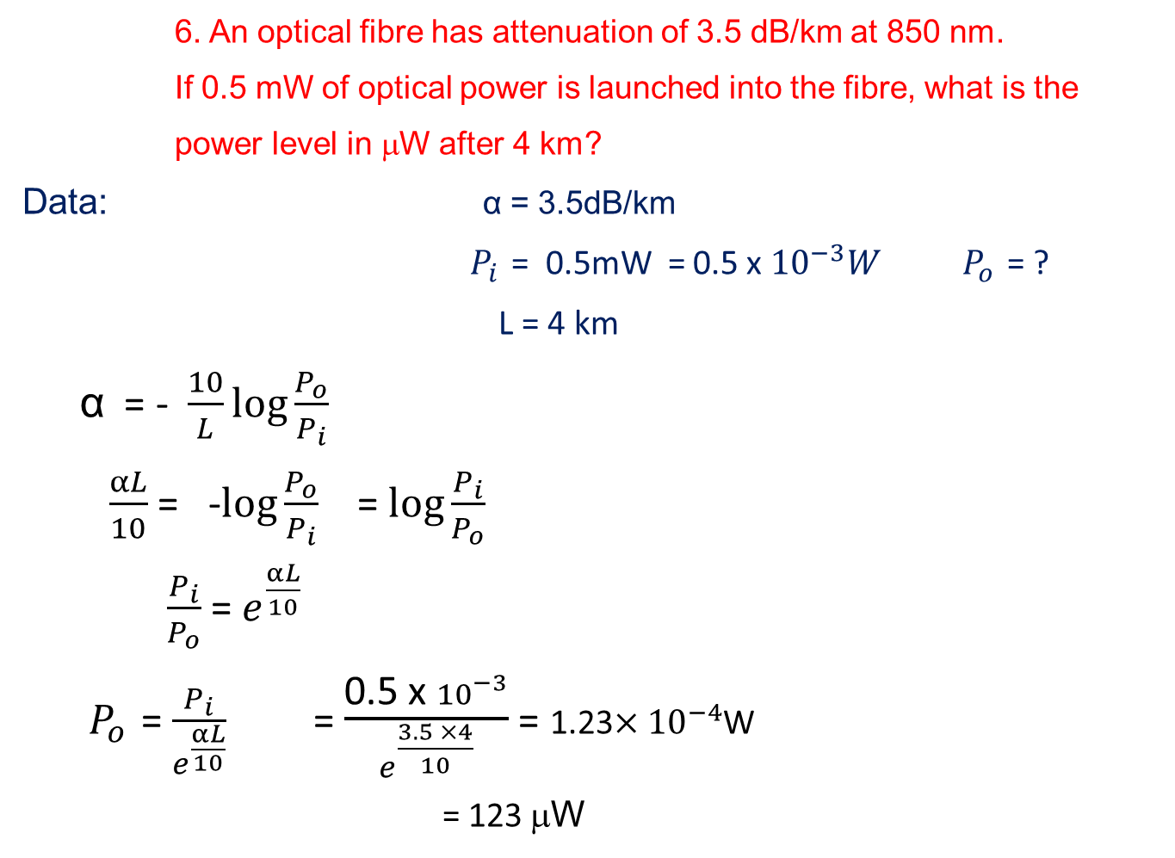
6. An optical fibre has attenuation of 3.5 dB/km at 850 nm.
If 0.5 mW of optical power is launched into the fibre, what is the
power level in μW after 4 km?
Data: α = 3.5dB/km
${ P}_{i }$= 0.5mW = 0.5 x ${10}^{−3}W$ $P_{o }$= ?
L = 4 km
α = - $\frac{10}{L}\log{\frac{P_{o}}{P_{i}}}$
$\frac{αL}{10}$ = -$\log{\frac{P_{o}}{P_{i}}}$ = $\log{\frac{P_{i}}{P_{o}}}$
$\frac{P_{i}}{P_{o}}$ = $e^{\frac{αL}{10}}$
${ P}_{o }$= $\frac{P_{i}}{e^{\frac{αL}{10}}}$ = $\frac{\text{0.5 }\text{x} {10}^{−3}}{e^{\frac{3.5 ×4}{10}}}$ = 1.23$×{10}^{−4}$W
= 123 μW

Slide 68
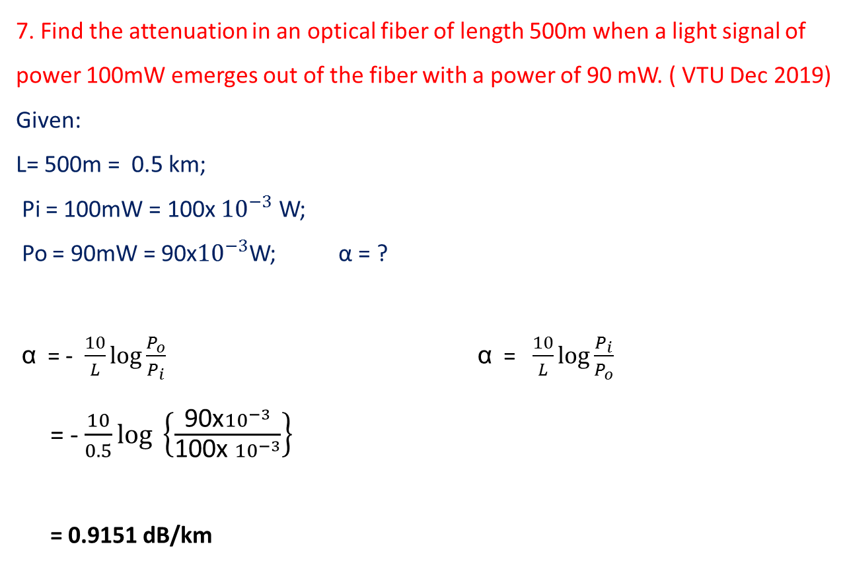
7. Find the attenuation in an optical fiber of length 500m when a light signal of power 100mW emerges out of the fiber with a power of 90 mW. ( VTU Dec 2019)
Given:
L= 500m = 0.5 km;
Pi = 100mW = 100x ${10}^{−3}$ W;
Po = 90mW = 90x${10}^{−3}$W; α = ?
α = - $\frac{10}{L}\log{\frac{P_{o}}{P_{i}}}$ α = $\frac{10}{L}\log{\frac{P_{i}}{P_{o}}}$
= - $\frac{10}{0.5}\log{ \left\{\frac{\text{90}\text{x}{10}^{−3}}{\text{100}\text{x} {10}^{−3}}\right\} }$
= 0.9151 dB/km

Slide 69
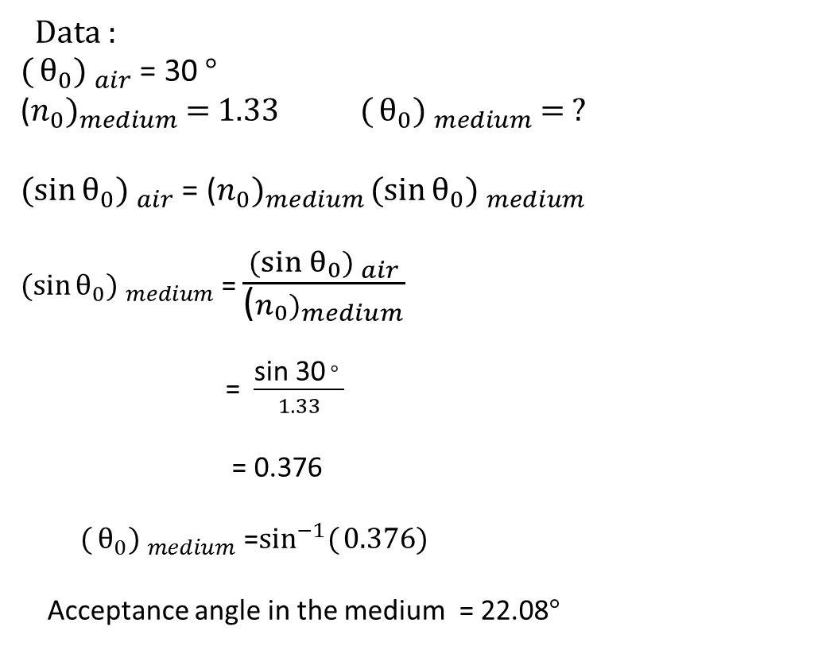
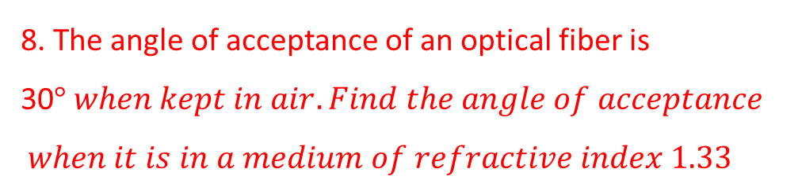
8. The angle of acceptance of an optical fiber is 30$° when kept in air. Find the angle of acceptance$
$$when it is in a medium of refractive index 1.33$$
Data :
${({θ_{0}) }}_{air}$ = 30 $°$
(${n_{0})}_{medium}$ = 1.33 ${({θ_{0}) }}_{medium}$ = ?
${(sin{θ_{0}) }}_{air}$ = (${n_{0})}_{medium}{(sin{θ_{0}) }}_{medium }$
${(sin{θ_{0}) }}_{medium}$ = $\frac{{(sin{θ_{0}) }}_{air}}{\text{(}{n_{0})}_{medium}}$
= $\frac{\text{sin}\text{ 30} ° }{1.33}$
= 0.376
${({θ_{0}) }}_{medium}$ =$\sin^{−1}({0.376)}$
Acceptance angle in the medium = 22.08$°$

Slide 70
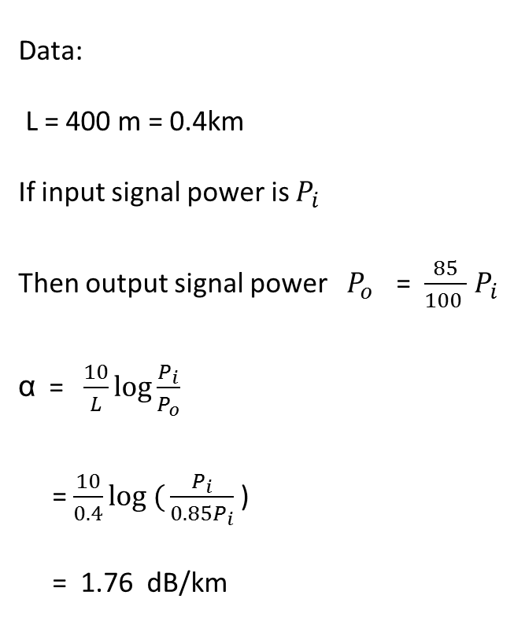
9. An optical signal looses 15% of its power after traversing a fiber length of 400m. Calculate the fiber loss.
Data:
L = 400 m = 0.4km
If input signal power is $P_{i }$
Then output signal power $P_{o }$ = $\frac{85}{100 }$ $P_{i }$
α = $\frac{10}{L}\log{\frac{P_{i}}{P_{o}}}$
= $\frac{10}{0.4}log ({\frac{P_{i}}{{0.85P}_{i}}}$ )
= 1.76 dB/km

